Slide 1
AIDI1012 - 23W AI ROBOTICS AND AUTOMATION​ ASSIGNMENT 3​
A2 Group Members​
Shivani Bajaj(200527764) ​
Cheuk Ying Iu(200514612)​
Fangji Chen(200520598)​
Ayesha Siddiqa(200502171)​
Taekeon Kim(200452564)​
Shivansh Setia(200511522)​
Harshal Shashikant Bhasgauri(200499159)​
Hamza Kadodia(200535827)​
Sahil Singal( 200506536)​
Himanshu (200535823)​

Slide 2
Redaction

Slide 3
Redaction means censoring or obscuring a part of a file (text, audio, image, document, video, etc.). This is done prior to the release of the file to hide information contained within for security, legal or compliance purposes.
Usually, compliance or the law necessitate redaction. The concealment of personal data about people or organizations is also done out of ethical obligation. The following list of information kinds that should generally be redacted:
Personally Identifiable Information:
PII refers to data that can be used alone or in conjunction with other data to identify a specific person. Direct identifiers (such a driver's license number) and quasi-identifiers can be used to classify it (such as race).
2. Faces or Persons:
The body or face of a person need not be censored in most cases. However, there are some situations where this might be required.
3. Objects:
As objects are not directly personal information, the requirements for their redaction are less stringent.
4. License Plates:
Although there aren’t many direct rulings on redaction of license plate numbers, and certain jurisdictions, it’s still information that can be wrongfully used.

Slide 4
Image Redaction

Slide 5


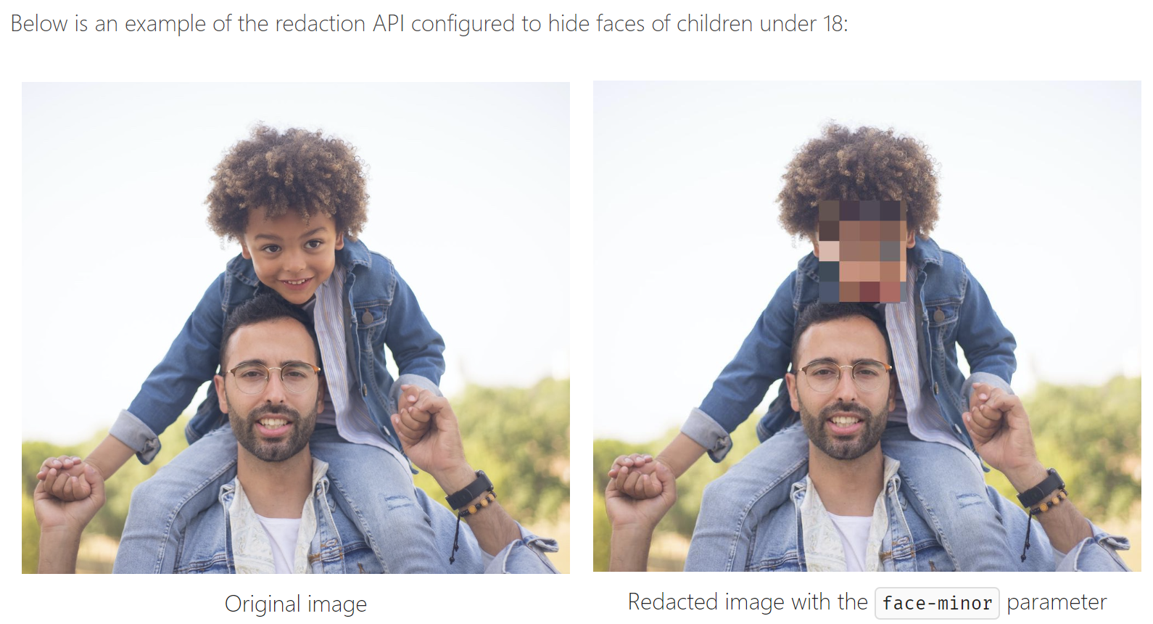
The Image Redaction means striking out of specific information (private data like a social security number or a settlement amount) on an image, such as a TIFF or JPEG, or on a PDF
There are several different ways to achieve image redaction, depending on the type of redaction needed and the tools available. Here are some common methods:
Manual redaction: This involves using an image editing software such as Adobe Photoshop or GIMP to manually edit the image by selecting the sensitive areas and covering them with a solid color, such as black or white.
Blurring: Blurring involves applying a filter to the sensitive areas of the image, which makes them difficult to recognize while still preserving the overall image. This technique is often used when the redacted areas are small or scattered throughout the image.
Pixelation: Similar to blurring, pixelation involves replacing the sensitive areas of an image with small, colored squares or pixels. This technique is often used when a high level of anonymity is required, as it makes it nearly impossible to recognize any details in the redacted area.
Cropping: Sometimes, redaction can be achieved simply by cropping the sensitive areas out of the image. This is most effective when the sensitive areas are located near the edges of the image.
Automatic redaction: Some software tools use artificial intelligence to automatically identify and redact sensitive information from images. This method is most effective when dealing with large numbers of images or when the sensitive areas are consistent in size and location.

Slide 6
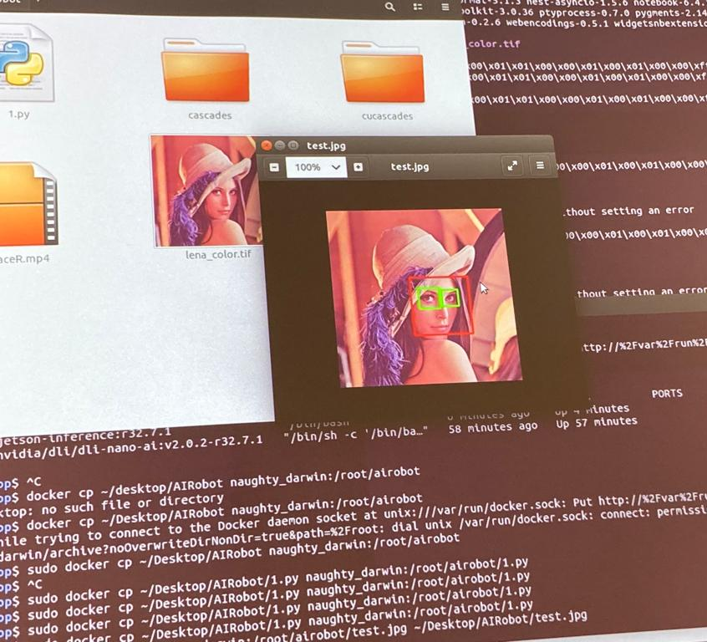
Face and Eye Recognition

Slide 7
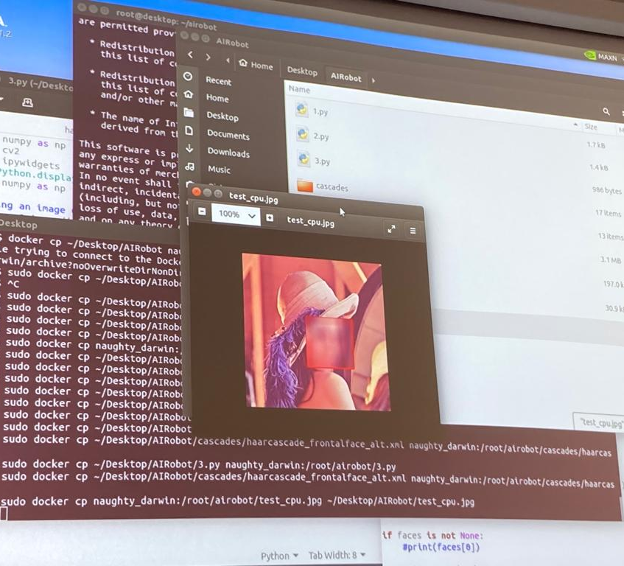
Redact an image - CPU

Slide 8
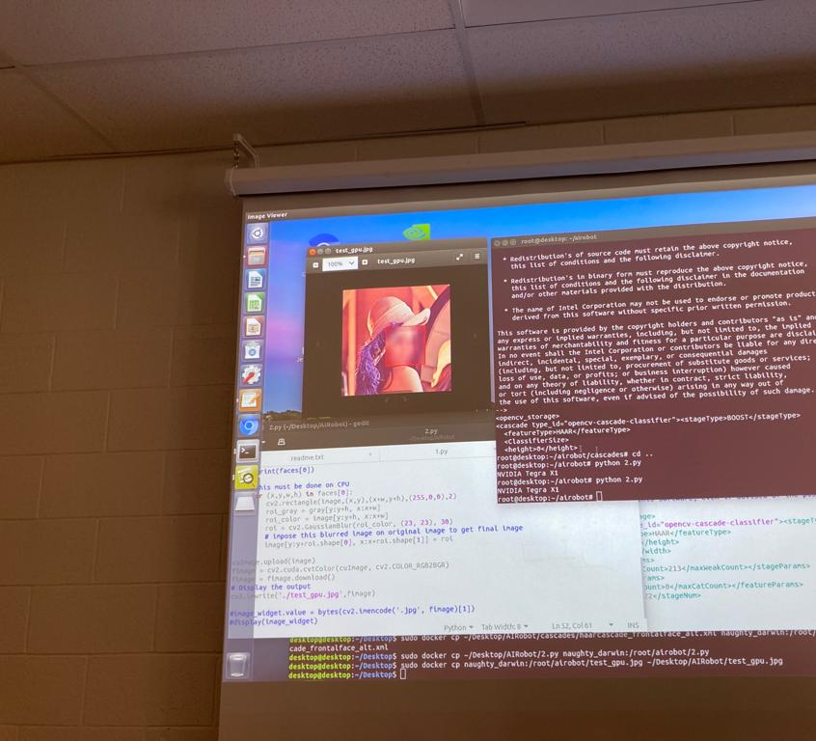
Redact an image - GPU

Slide 9
Video Redaction

Slide 10
Video redaction is the process of obscuring or removing certain information from a video that is considered sensitive, confidential, or private. The purpose of redaction is to protect the privacy and security of individuals, organizations or government entities that may be seen in the video footage or have their personal information disclosed.
Here are the general steps to achieve video redaction:
Identify the sensitive information: Review the video footage to identify the information that needs to be redacted, such as faces, license plates, addresses, or other personally identifiable information.
Determine the level of redaction: Decide on the level of redaction required, depending on the sensitivity of the information and the purpose of the video.
Select a redaction method: Choose the appropriate method of redaction, whether it's manual redaction or automated redaction using specialized software.
Apply redaction: Use a video editing software to apply the redaction, either by manually selecting the areas to be redacted and applying a black box or blur effect or by using automated software to detect and redact the sensitive information.
Review the redacted video: After applying the redaction, review the video to ensure that the sensitive information is properly obscured or removed, and that the redaction does not affect the overall quality or clarity of the video.
Save and secure the redacted video: Save the redacted video in a secure location with restricted access, and maintain a record of the redaction process for future reference.
It is important to note that the redaction process can vary depending on the specific requirements and regulations of the organization or industry. Additionally, automated redaction software may require specific training and expertise to use effectively.

Slide 11
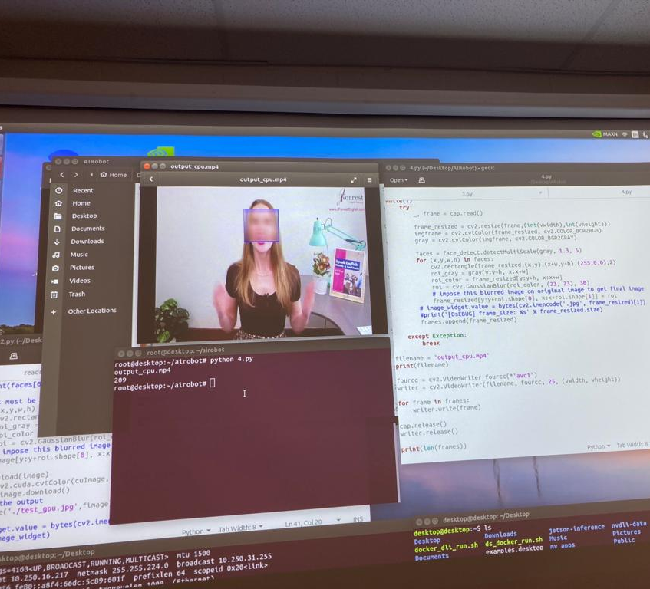
Video Redaction - CPU

Slide 12
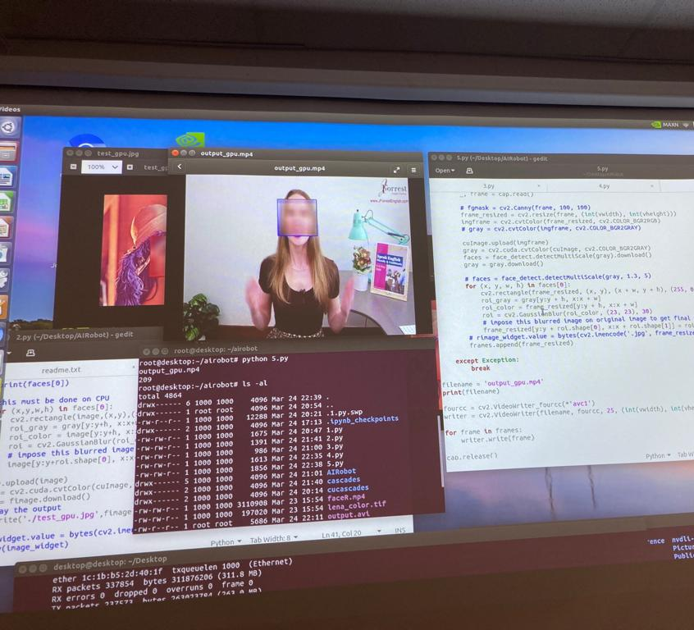
Video Redaction - GPU

Slide 13
Image Redaction vs Video Redaction (Comparisons)

Slide 14
Image Redaction vs Video Redaction
Image redaction is the process of removing or obscuring specific information from an image to protect sensitive information or maintain privacy.
Complexity: images consist of 2D array of pixel values. It becomes comparatively easier to locate the desired area of blurring/redaction.
Input type: images are typically loaded as 2D arrays of pixel values.
Scope: Image redaction involves a well-defined scope as images are limited to a single frame.
Temporal consistency: not required as we work with a single frame
VIDEO REDACTION, ON THE OTHER HAND, IS THE PROCESS OF OBSCURING OR REMOVING CERTAIN PARTS OF A VIDEO FOR PRIVACY OR SECURITY REASONS.
Complexity: Video redaction is typically more complex than image redaction because videos are made up of a sequence of images (frames), which must be redacted in a consistent manner to maintain continuity.
Input type: videos are loaded as a sequence of images. This means that video redaction requires additional processing
Scope: Video redaction usually involves a larger scope because videos can contain multiple scenes, angles, and people, while images are typically limited to a single frame.
Temporal consistency: Video redaction requires maintaining temporal consistency between frames, meaning that the same area of an image must be redacted in each frame to avoid revealing sensitive information

